Slide 1
User Experience Design
Android Design Patterns
Saleem M. Shublaq
Teaching Assistant at Islamic University of Gaza
Software Development Department
Lecturer at University College Of Applied Sciences
Information Technology Department
Android / iOS Developer

Slide 2
Agenda
What is UX ?
Difference Between UX And UI
Wireframing
Case Study
AntiPattern
Android Design Pattern

Slide 3
What is UX ?
Is the process of enhancing customer satisfaction and loyalty by improving the usability, ease of use, and pleasure provided in the interaction between the customer and the product.

Slide 4
Difference Between UX And UI
UX Design refers to the term User Experience Design, while UI Design stands for User Interface Design. Both elements are crucial to a product and work closely together.
But despite their professional relationship, the roles themselves are quite different, referring to very different parts of the process and the design discipline.
Where UX Design is a more analytical and technical field, UI Design is closer to what we refer to as graphic design, though the responsibilities are somewhat more complex.

Slide 5
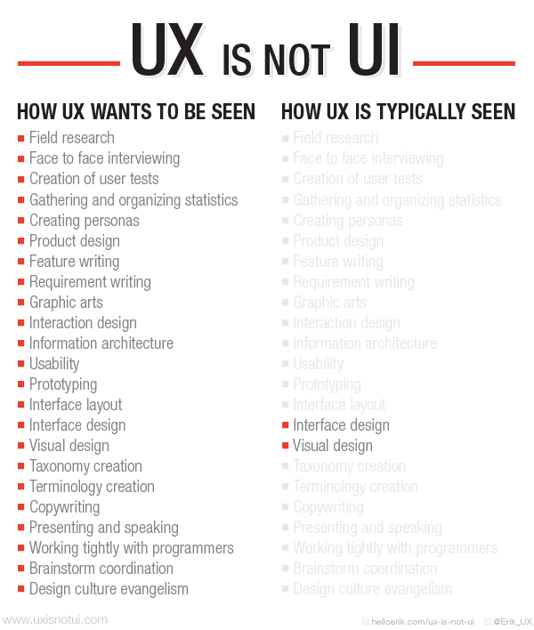

Slide 6
What is Wireframing ?
Wireframing is an important tool for product design and development.

Slide 7
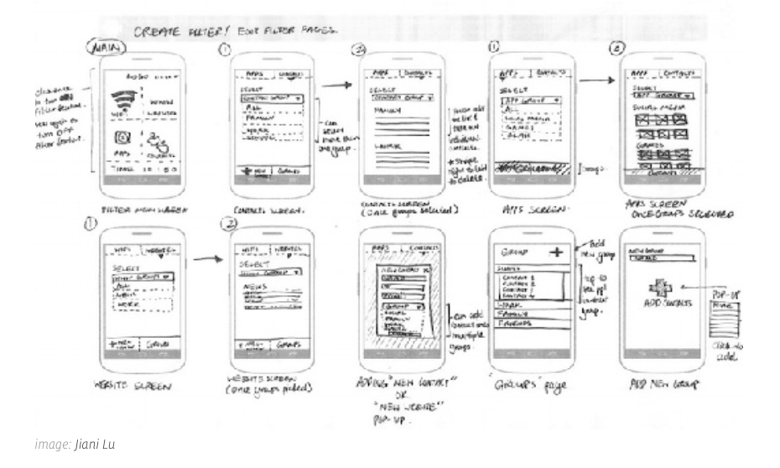

Slide 8
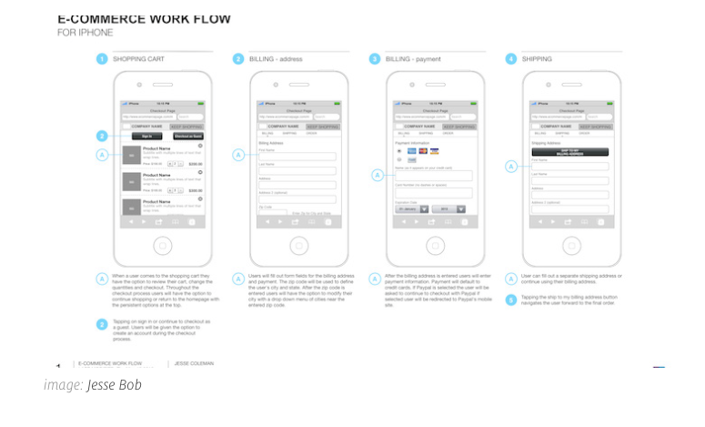

Slide 9
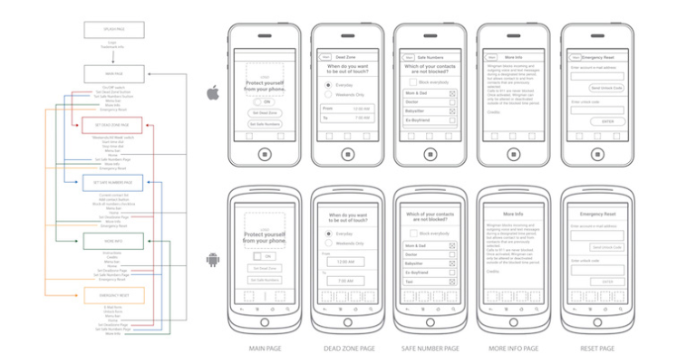

Slide 10
Wireframing - Tools
1. Sketching

Slide 11
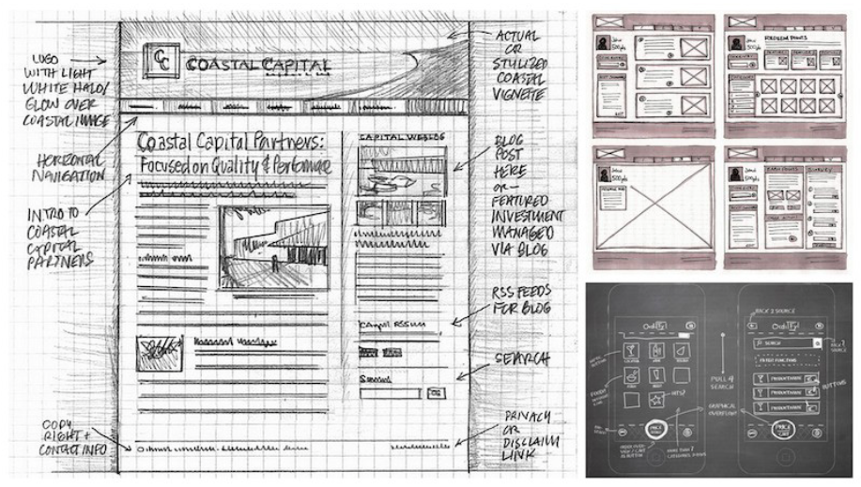

Slide 12
Wireframing - Tools
2. Paper Cutouts

Slide 13
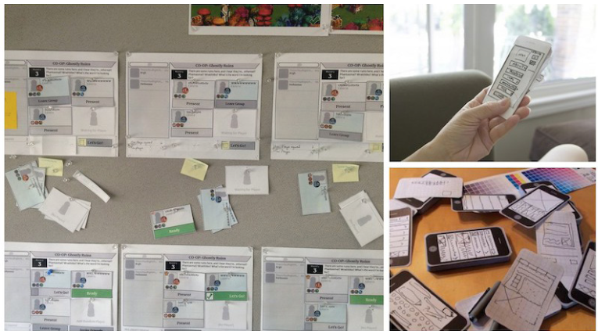

Slide 14
Wireframing - Tools
3. Stenciling

Slide 15
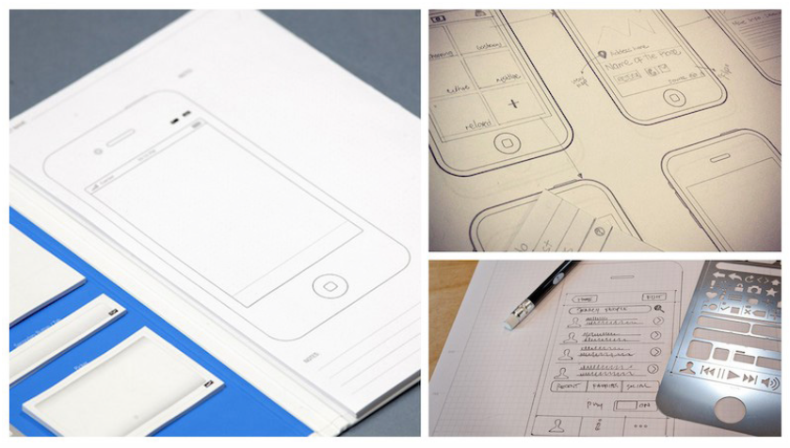

Slide 16
Wireframing - Digital Tools
4. Wireframing Software

Slide 17
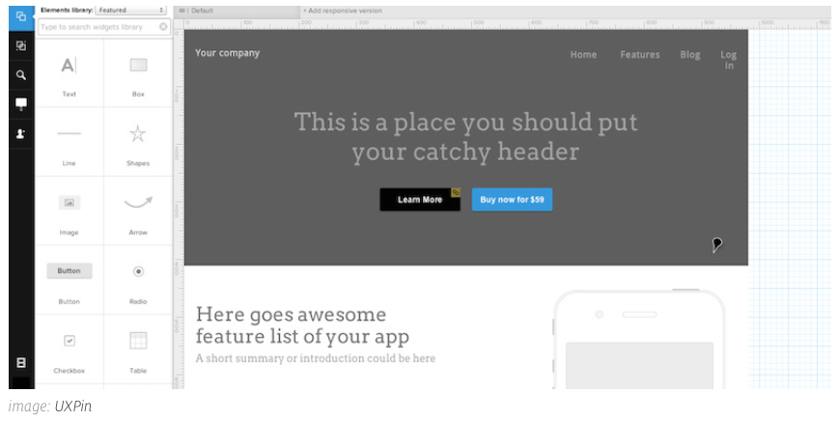

Slide 18
Wireframing - Digital Tools
5. Presentation Software

Slide 19
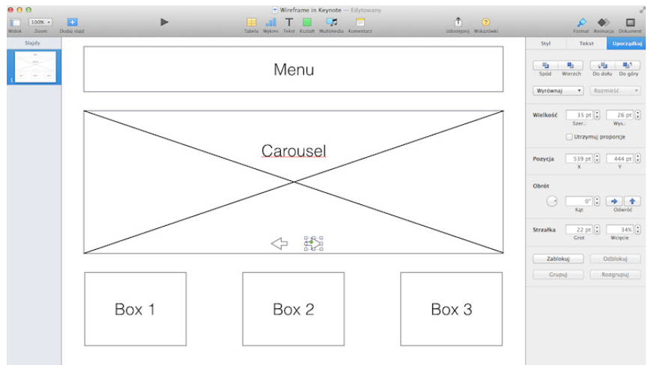

Slide 20
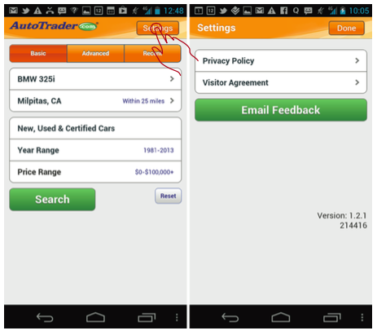
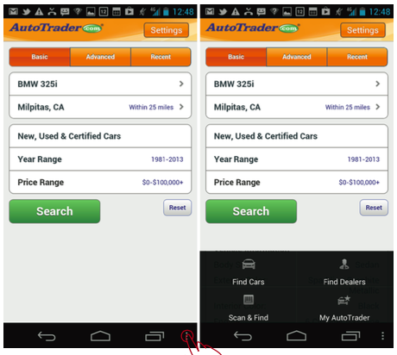
Case Study

Slide 21
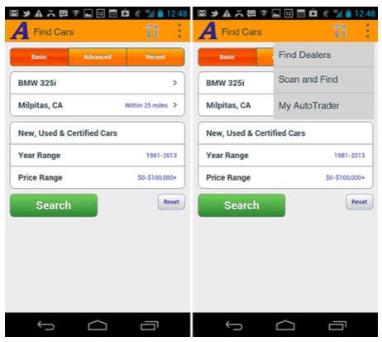
After

Slide 22
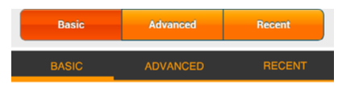
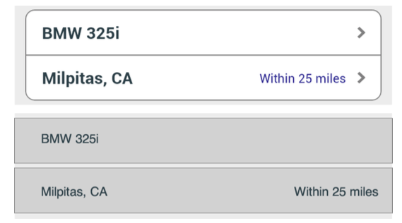
Case Study

Slide 23
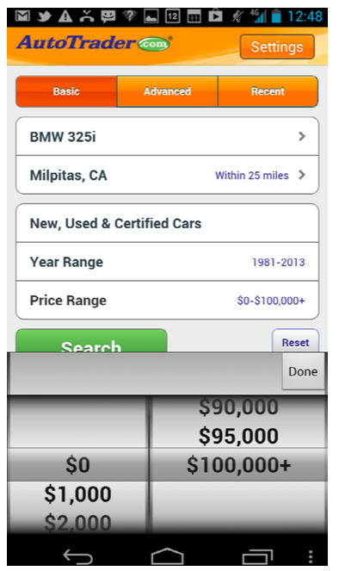

Slide 24
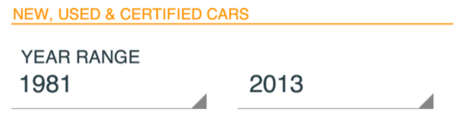
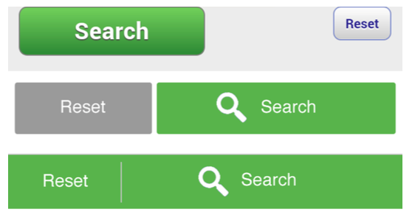
After

Slide 25
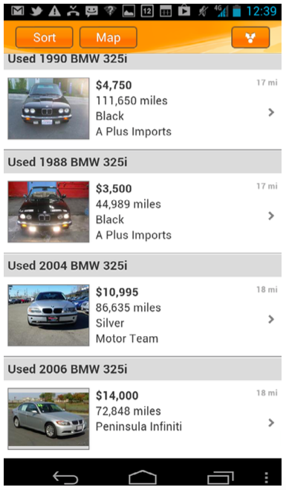
Search Result

Slide 26
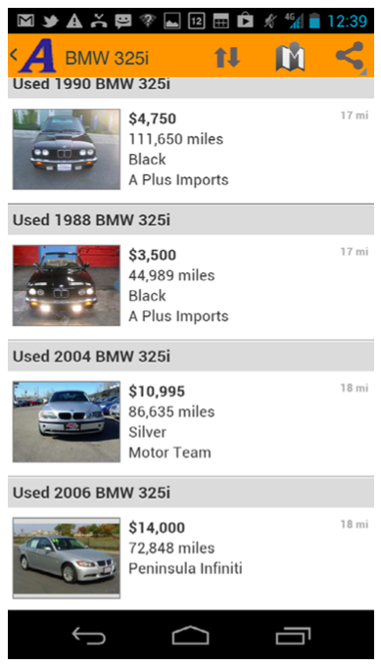
After

Slide 27
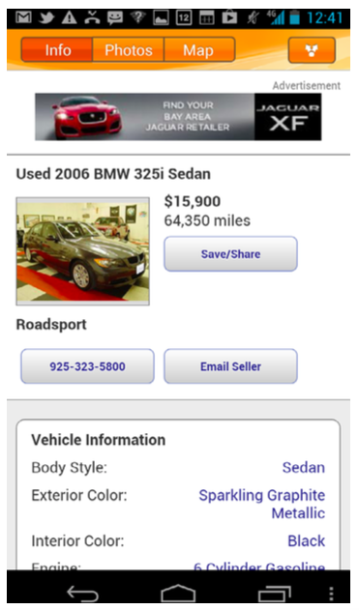
Result Details

Slide 28
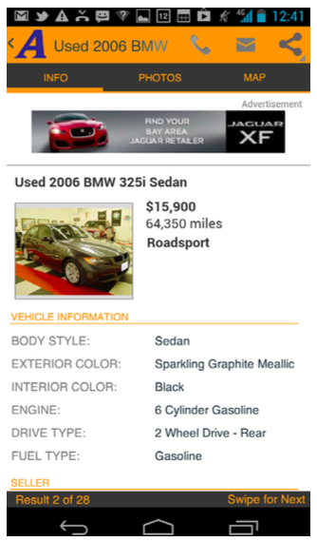
After

Slide 29
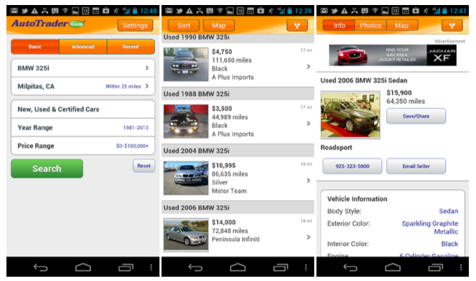
Bringing Together

Slide 30
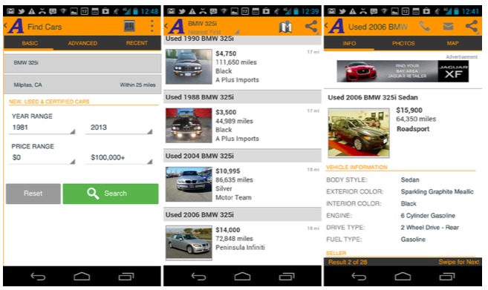
Bringing Together

Slide 31
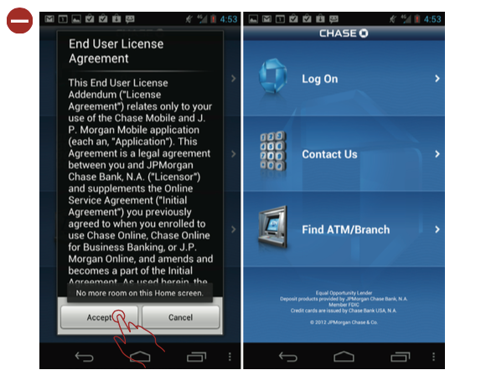
AntiPatterns - EULA

Slide 32
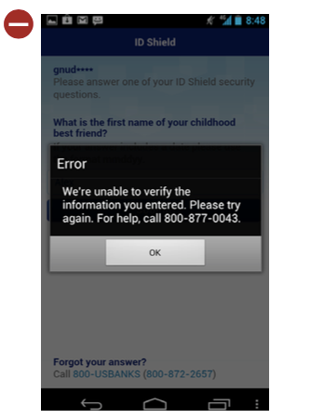
AntiPatterns - Contact Us

Slide 33
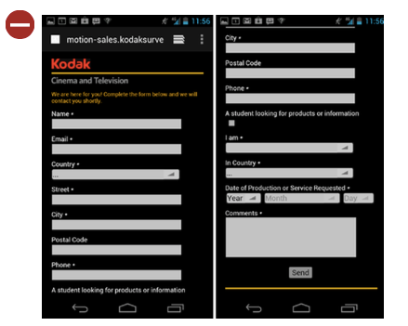
AntiPatterns - Sign Up

Slide 34
Android Design Patterns
Welcome Experience
Home Screen
List of Links ) Hub & Spoke )
Dashboard
Updates
Browse
Map
History
Search
Sorting and Filtering
Avoiding Missing or Undesirable Results
Data Entry
Forms
Mobile Banking
Navigation
Tablet Patterns

Slide 35
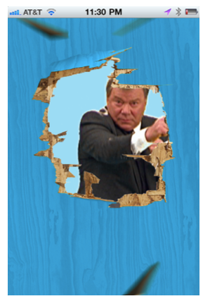
Welcome Screen

Slide 36
When and Where to Use It

Slide 37
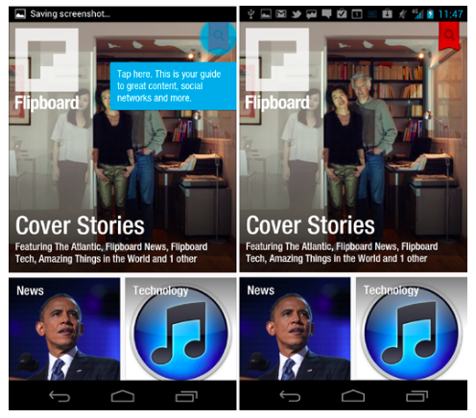
Tutorial Pattern

Slide 38
When and Where to Use It

Slide 39
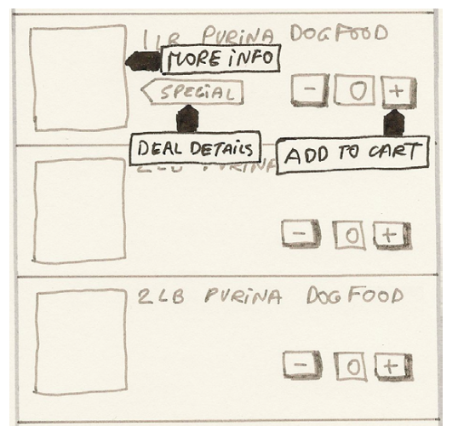
Tutorial Sketch

Slide 40
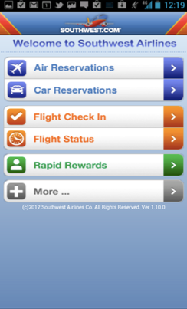
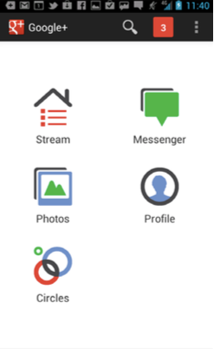
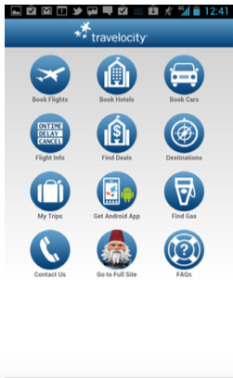
Home Screen - List of Links

Slide 41
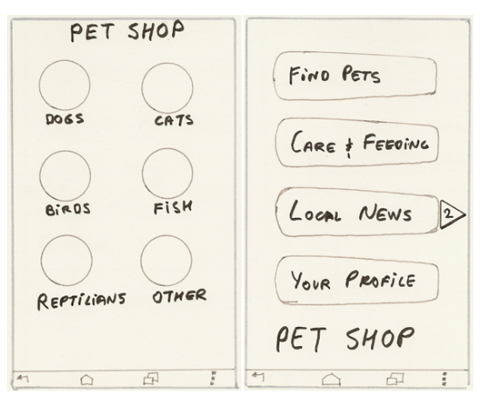
Sketch

Slide 42
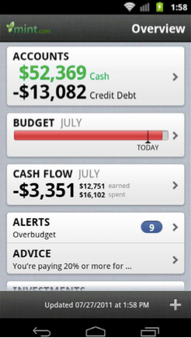
Home Screen - Dashboard

Slide 43
When and Where to Use It

Slide 44
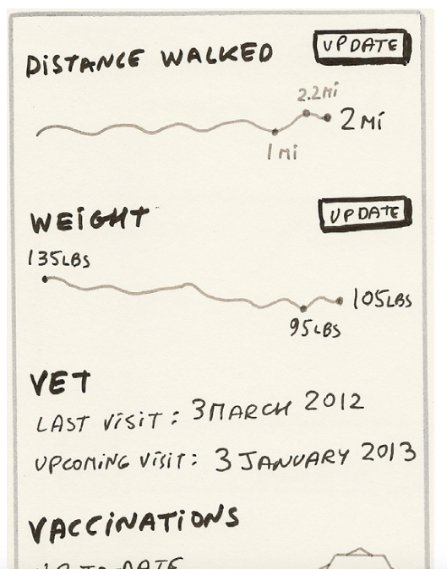
Sketch

Slide 45
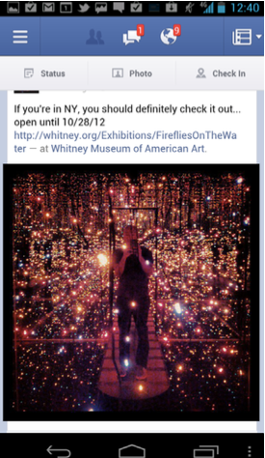
Home Screen - Updates

Slide 46
When and Where to Use It

Slide 47
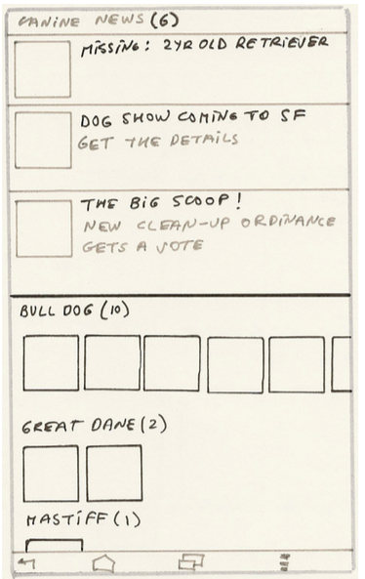
Sketch

Slide 48
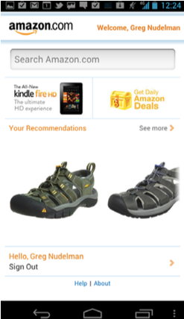
Home Screen - Browse

Slide 49
When and Where to Use It

Slide 50
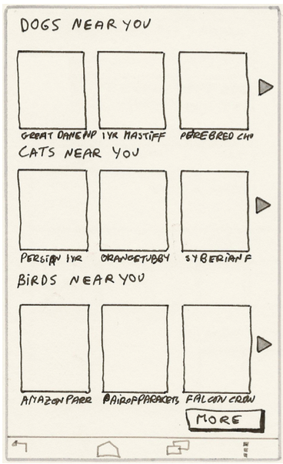
Sketch

Slide 51
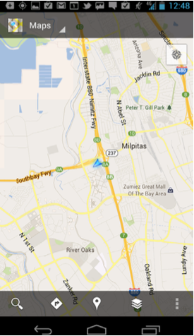
Home Screen - Map

Slide 52
When and Where to Use It

Slide 53
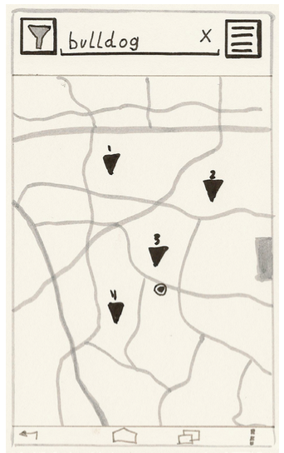
Sketch

Slide 54
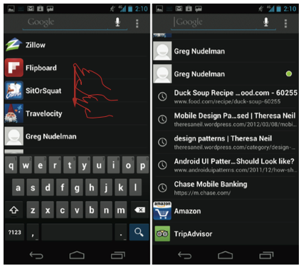
Home Screen - History

Slide 55
When and Where to Use It

Slide 56
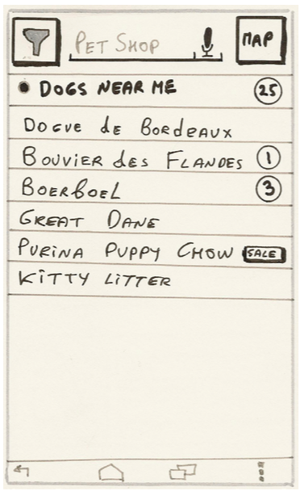
Sketch

Slide 57
Search Patterns
Voice Search
Auto Complete Auto Suggest
Tab Ahead
Pull to Refresh
Search from Menu
Search From Action Bar
Dedicated Search
Search in the Content Page

Slide 58
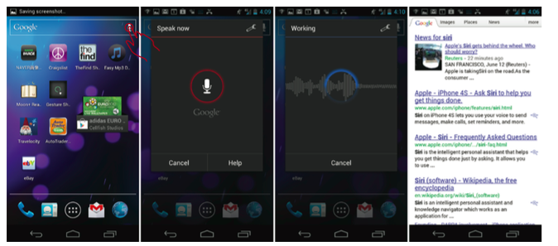
Voice Search

Slide 59
When and Where to Use It

Slide 60
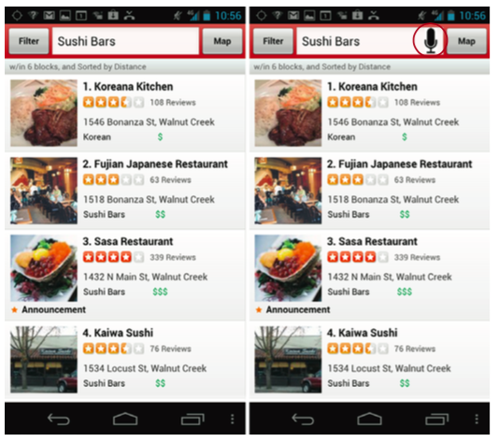
Yelp App

Slide 61
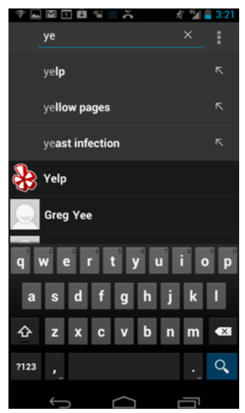
Auto-Complete and Auto-Suggest

Slide 62
Why Use It
Reduce spelling errors
Improve query specificity
Reduce zero results

Slide 63
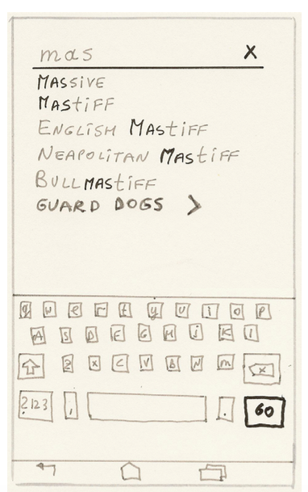
Sketch

Slide 64
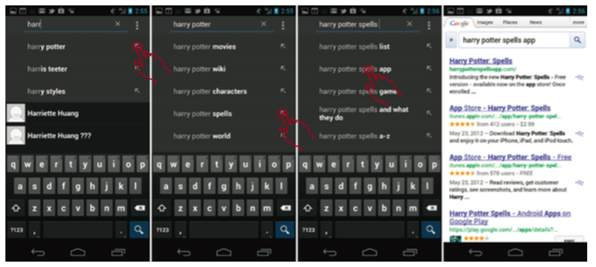
Tap-Ahead

Slide 65
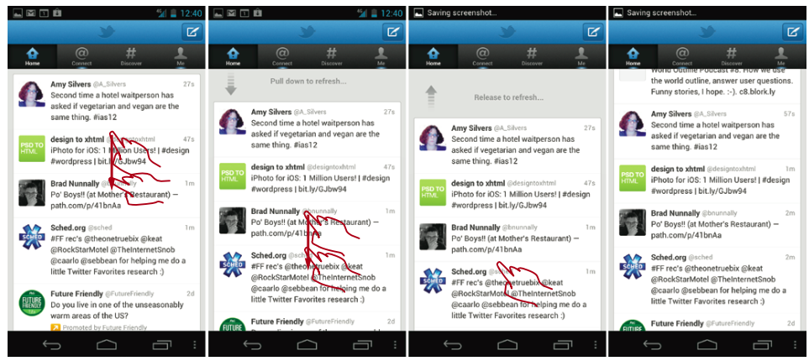
Pull To Refresh

Slide 66
When and Where to Use It

Slide 67
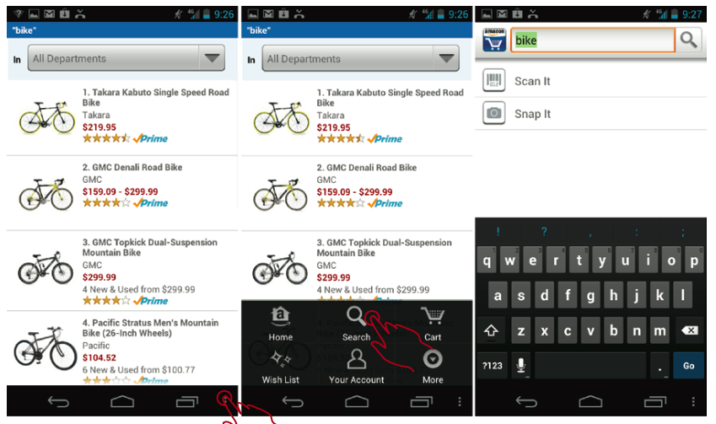
Search from Menu

Slide 68
When and Where to Use It
This pattern is now largely deprecated

Slide 69

Sketch

Slide 70

Search From Action Bar

Slide 71

Sketch

Slide 72

Dedicated Search

Slide 73
When and Where to Use It

Slide 74

Sketch

Slide 75

Search in Content Page

Slide 76
When and Where to Use It

Slide 77

Sketch

Slide 78

Anti Pattern Search & Refinement

